Slide 1


Malware REVERSE Engineering
WANNACRY

Slide 2



What is it?

Slide 3


Slide 4
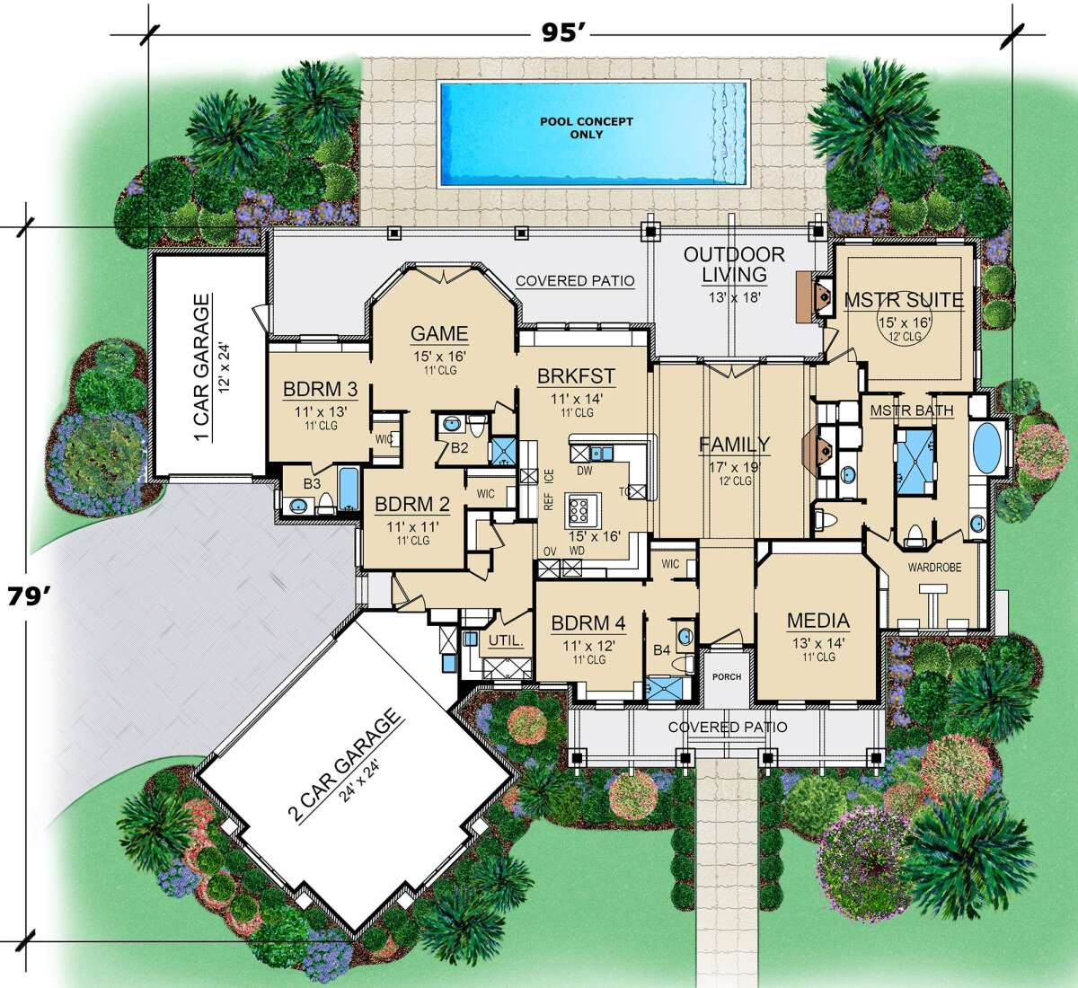

Slide 5



Slide 6
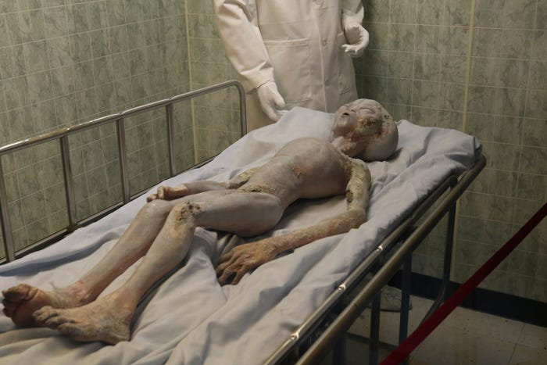

Slide 7

But why?
Understanding the adversary
Spotting indicators of compromise (IOCs)
Responding to an incident
Understanding intangible warfare

Slide 8
Malware Analysis
Basic Static Analysis - Limited tools and looking at the sample when it is not running.
Basic Dynamic Analysis - Executing the sample and collect basic information.

Slide 9
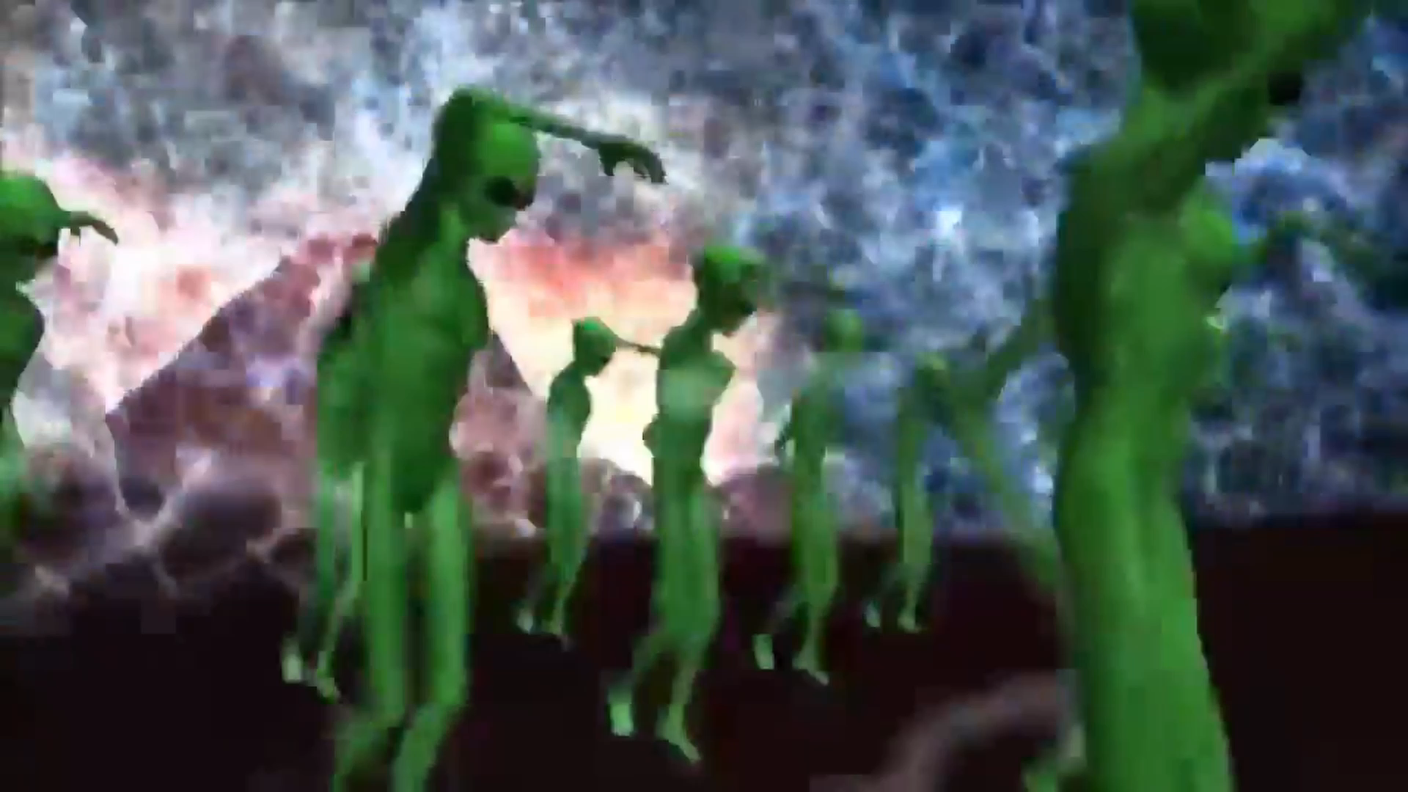

Slide 10
What do I need?
FlareVM – Specialized Windows Reverse Engineering VM
REMnux - Specialized Linux Reverse Engineering VM
MITRE ATT&CK – A framework to show how cyber attacks happen
Windows API – The different functions that make Windows Work

Slide 11

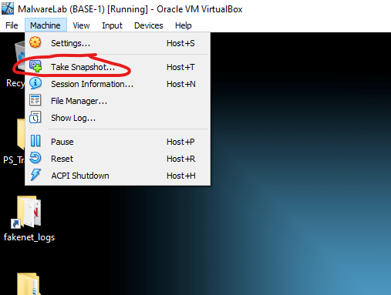
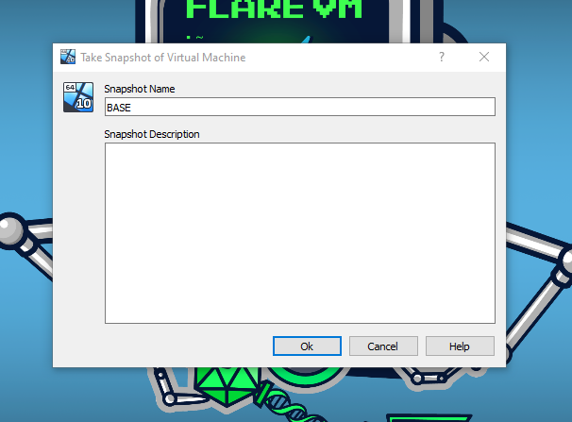
Malware safety

Slide 12
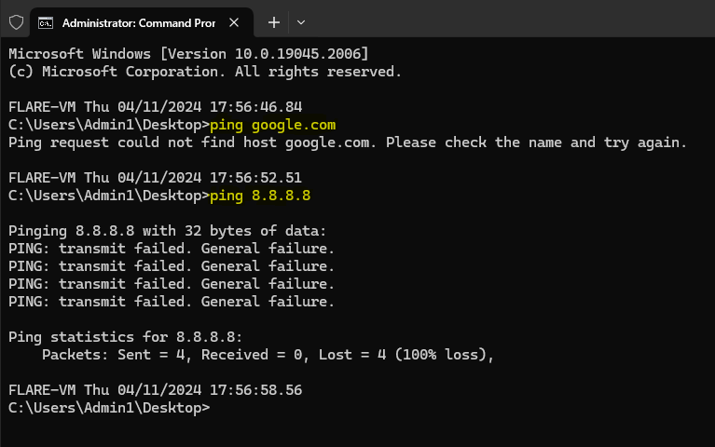
Malware safety

Slide 13
Time to Start!

Slide 14
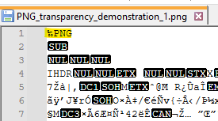
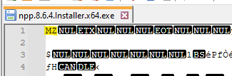
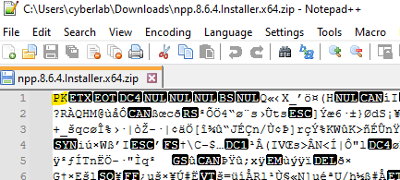
File headers

Slide 15
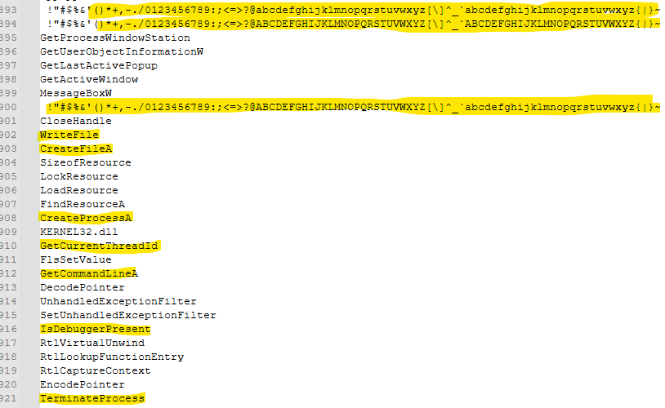
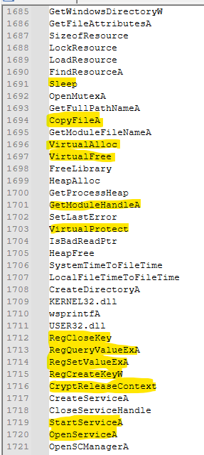
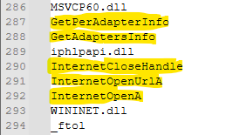

Slide 16
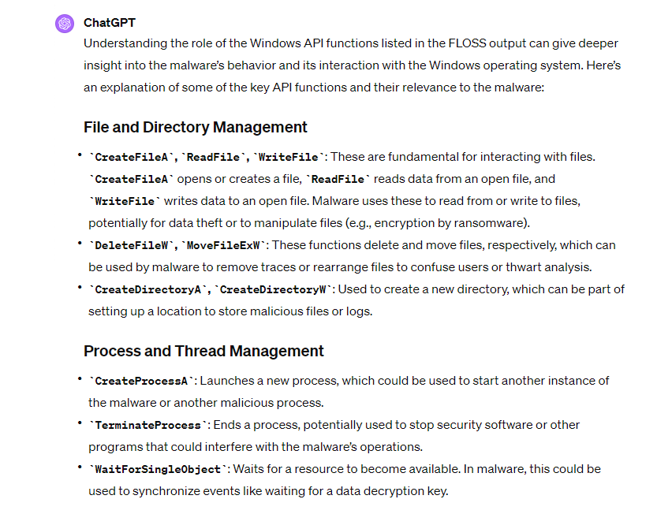
Using AI for malware

Slide 17
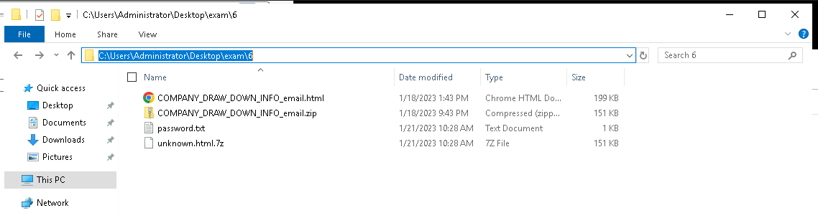
Basic Static Analysis: code Examination

Slide 18
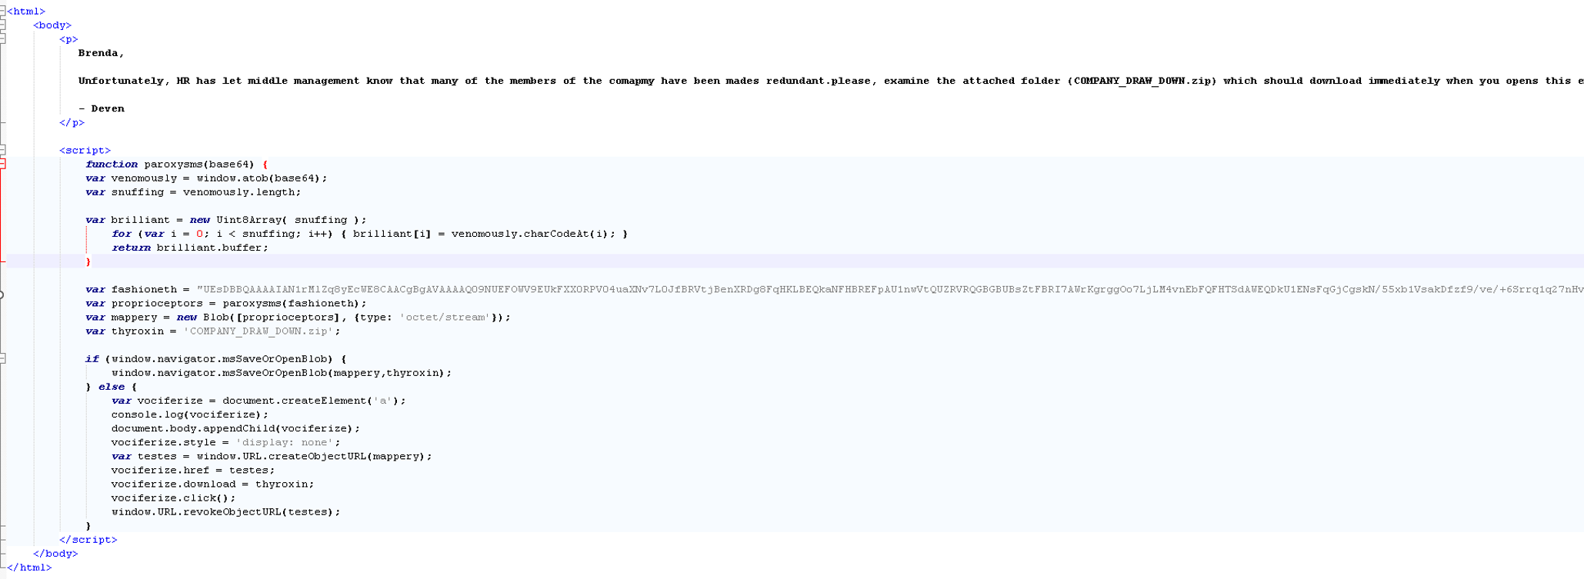
Basic Static Analysis: code Examination

Slide 19
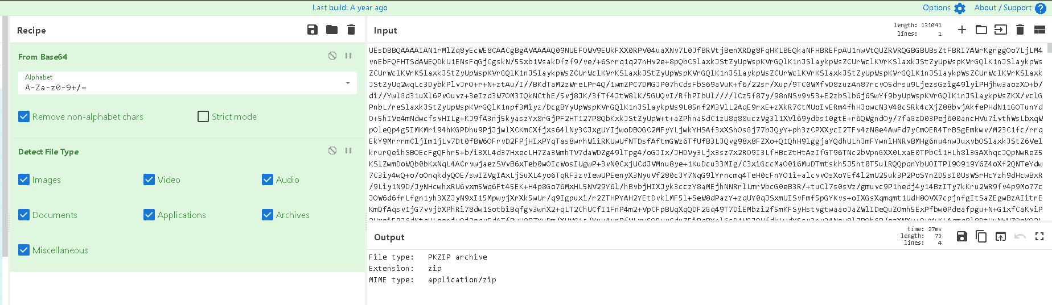
Basic Static Analysis: code Examination

Slide 20
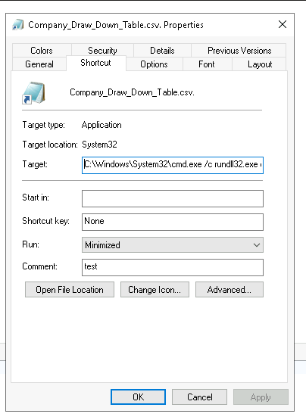
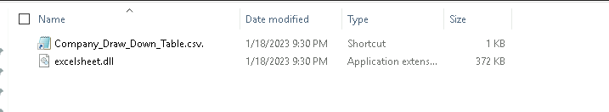
Basic Static Analysis: code Examination
C:\Windows\System32\cmd.exe /c rundll32.exe excelsheet.dll,DllMain

Slide 21
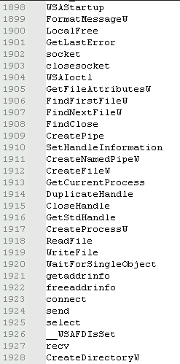
Basic Static Analysis: code Examination
GetFileAttributesA - Could be used to query file information
GetCurrentProcess - Querying a process handle
Readfile - Self explained
Writefile - Self explained

Slide 22
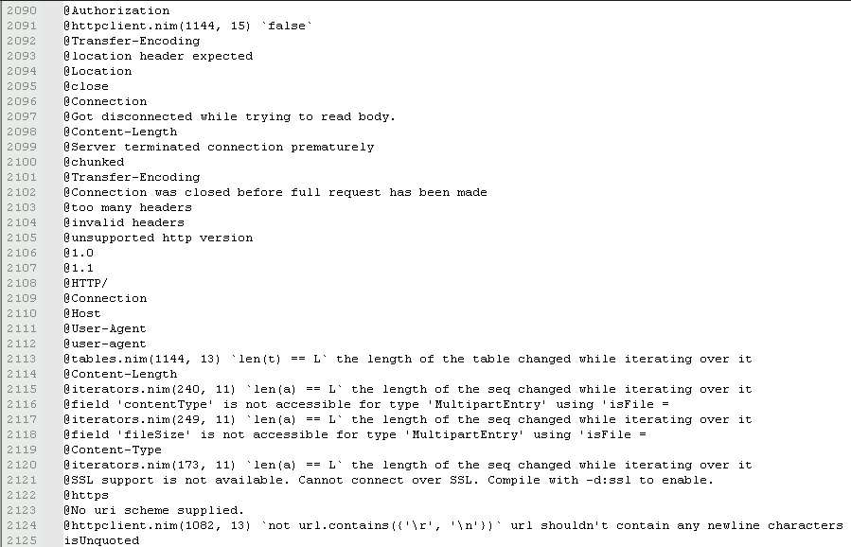
Basic Static Analysis: code Examination

Slide 23
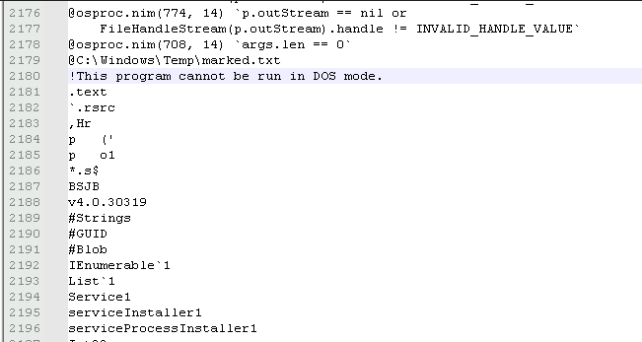
Basic Static Analysis: code Examination

Slide 24
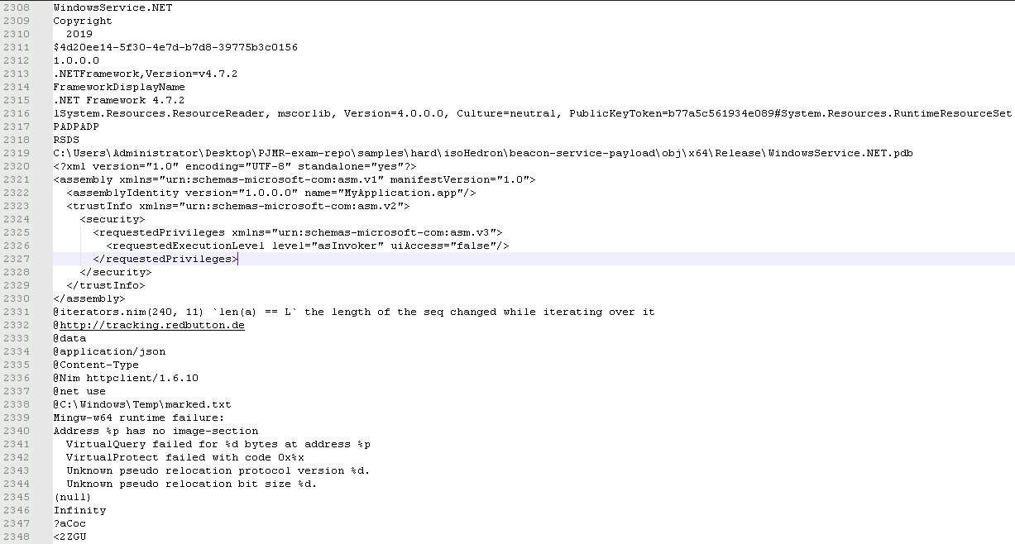
Basic Static Analysis: code Examination

Slide 25
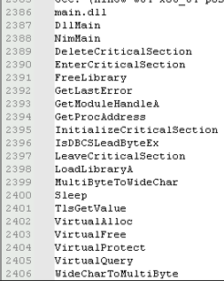
Basic Static Analysis: code Examination
GetProcAddress - Could be used to call certain functions in an evasive way.
GetModuleHandleA - Calls certain module handles from GetProcAddress
LoadLibraryA - Used to load in other maliciously functions into the PE evasively.
Sleep - Could be used to for delay of code execution for time based evasion.
VirtualQuery - Could help with memory enumeration for a process injection.
VirtualProtect - Used to strip memory protection for process injections.
VirtualAlloc - Used to allocate memory as a part of process injection

Slide 26
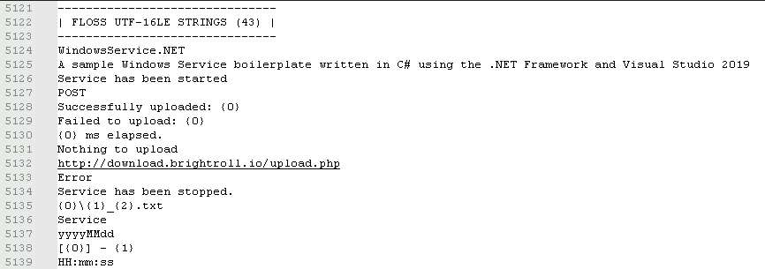
Basic Static Analysis: code Examination

Slide 27
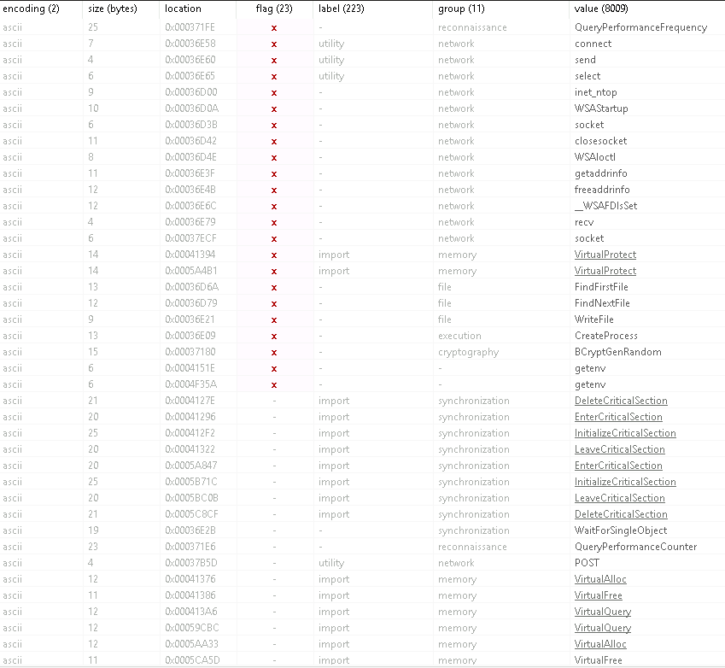
Basic Static Analysis: PEStudio

Slide 28
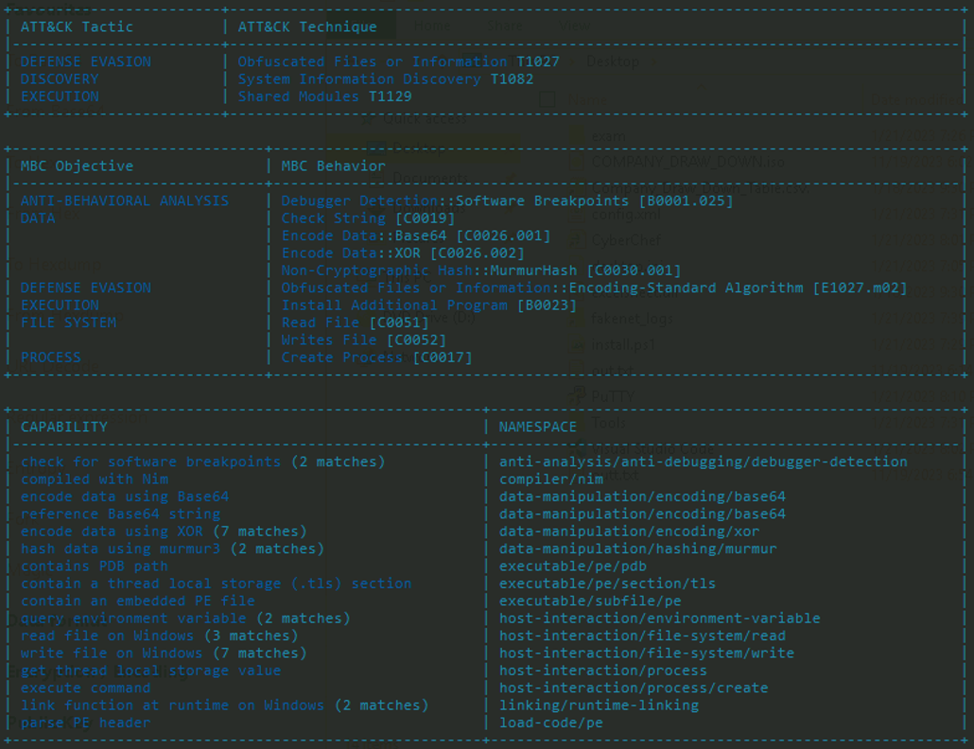
Basic Static Analysis: CAPA

Slide 29
Basic Static Analysis: CAPA
MITRE ATT&CK:
Defense Evasion: Obfuscated File or information [T1027]
Discovery: System Information Discovery [T1082]
Execution: Shared Modules [T1129]
MITRE MBC:
Anti Behavioral analysis: Debugger detection of software breakpoints [B0001.025]
Data: Encode data with Base64 and XOR: [C0026.001] and [C0026.002]
Execution: Install additional program [B0023]
File system: Read and write files [C0051] and [C0052]
Process: Create Process [C0017]

Slide 30
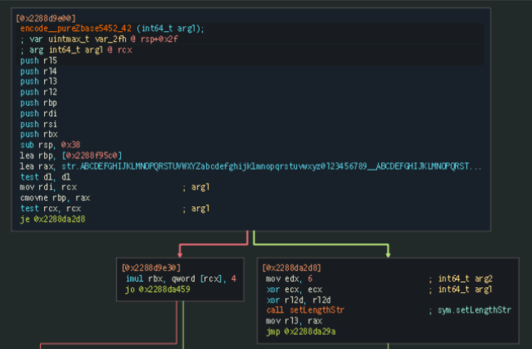
Advanced Static Analysis: Cutter
MITRE ATT&CK:
Defense Evasion:
Obfuscated File or information [T1027]
MITRE MBC:
Defense Evasion:
Obfuscated Files or Information:
Encoding-Standard Algorithm [E1027.m02]
Memory Location:
0x2288D9E00

Slide 31
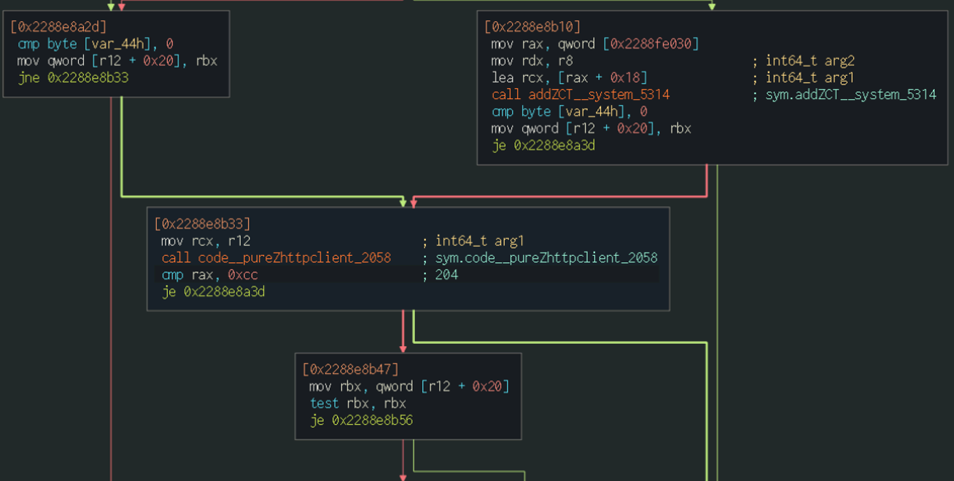
Advanced Static Analysis: Cutter
MITRE MBC:
Anti-Behavioral Analysis:
Debugger Detection:
Software Breakpoints [B0001.025]
Memory Location:
0x2288E8B3B

Slide 32
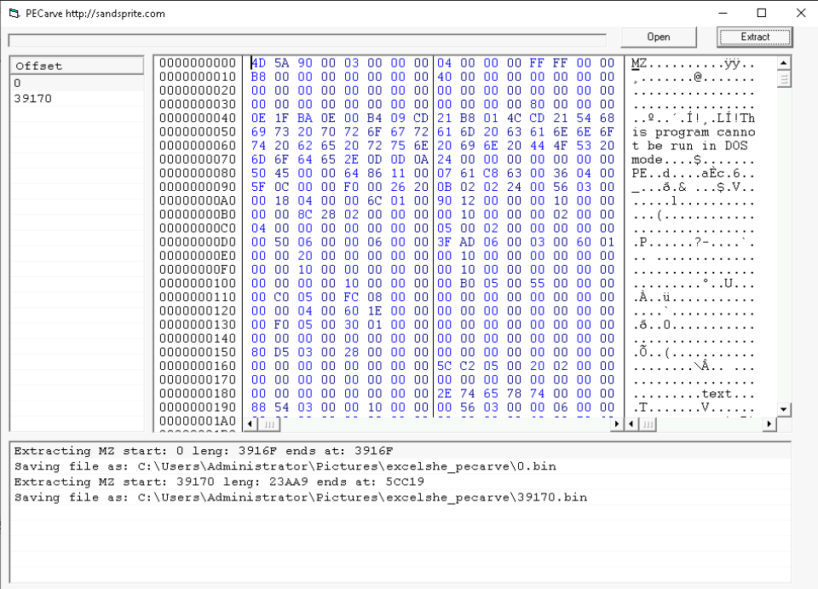
Advanced Static Analysis: PEcarve

Slide 33
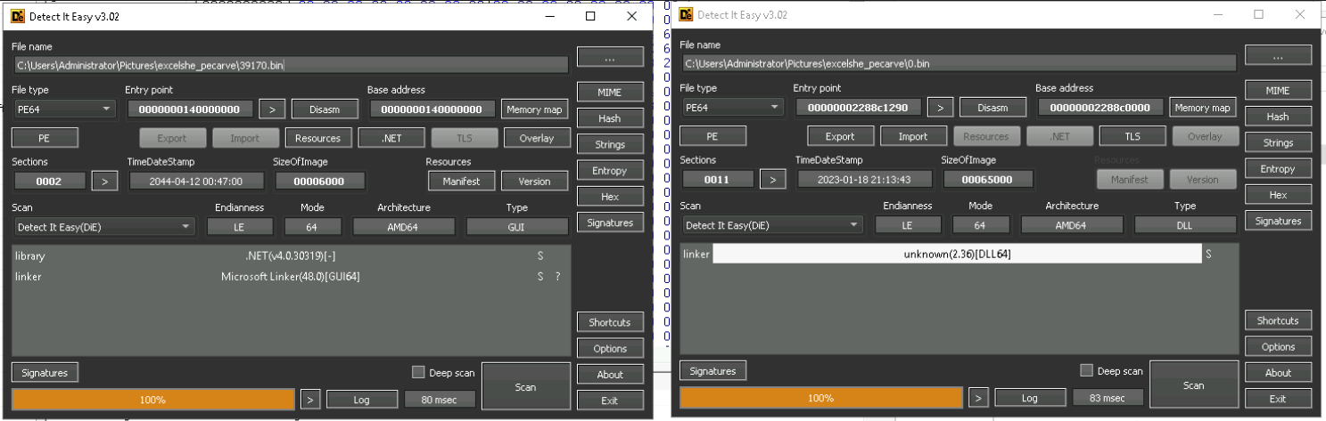
Advanced Static Analysis: detect it easy

Slide 34
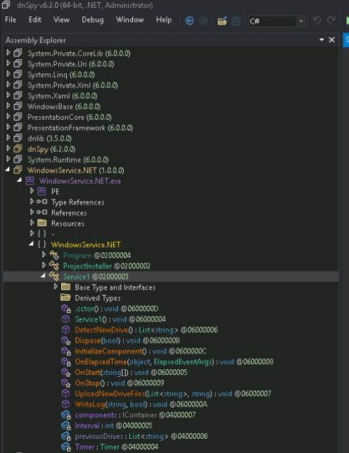
Advanced Static Analysis: dnspy

Slide 35
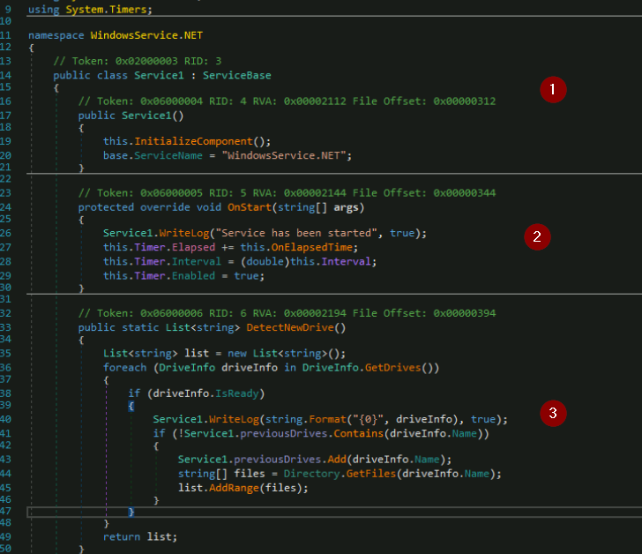
Advanced Static Analysis: DNSPY
1. Initialization of WindowsService.NET
2. Logging the service with a timer
3. The querying of drive information with DetectNewDrive and the DriveInfo functions.

Slide 36
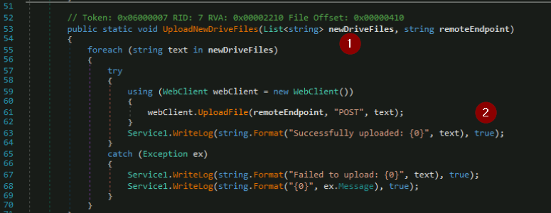
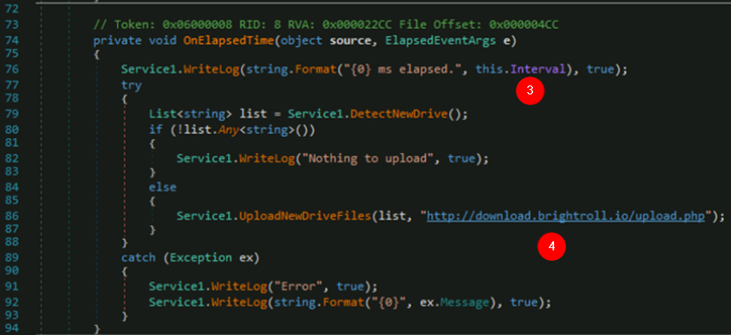
Advanced Static Analysis: DNSPY
1. Line 53 shows the UploadNewDriveFiles function to upload the drive information to a remote URL.
2. Upload is initiated with a “POST” method and logging is seen.
3. The WriteLog function is seen writing the time elapsed and writes new drive information.
4. The drive information has been logged the and the UploadNewDriveFiles function uploads the drive information to the URL.

Slide 37
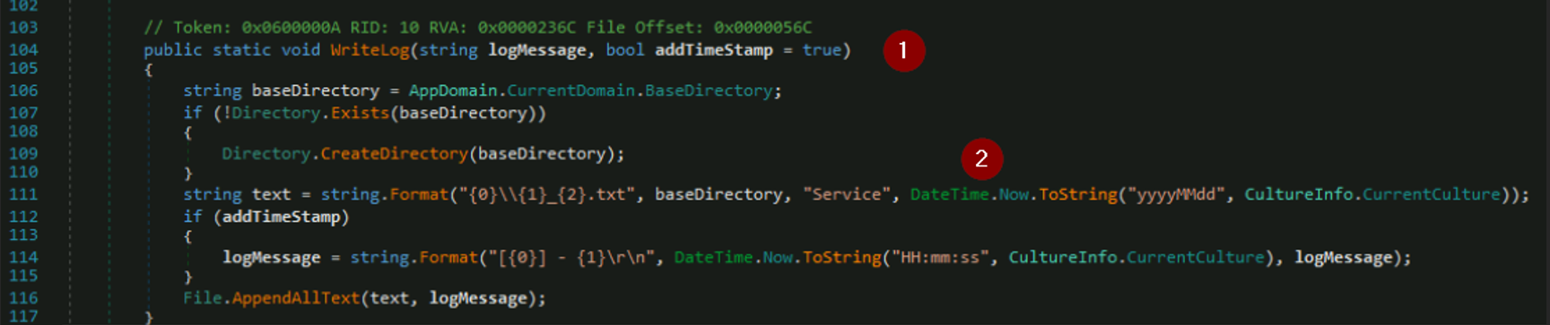
Advanced Static Analysis: DNSPY
1. The Writelog function is mentioned for logging along with addTimeStamp to add timestamps to the log.
2. Time and date information is appended to the log.

Slide 38
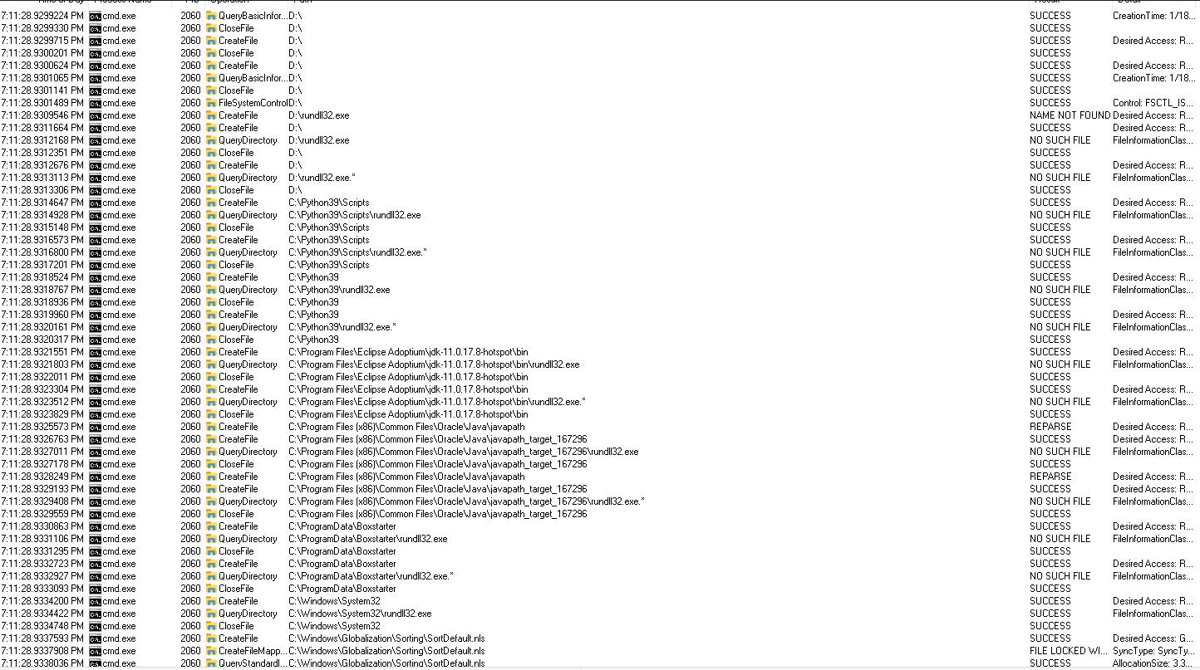
Basic Dynamic Analysis: Procmon

Slide 39
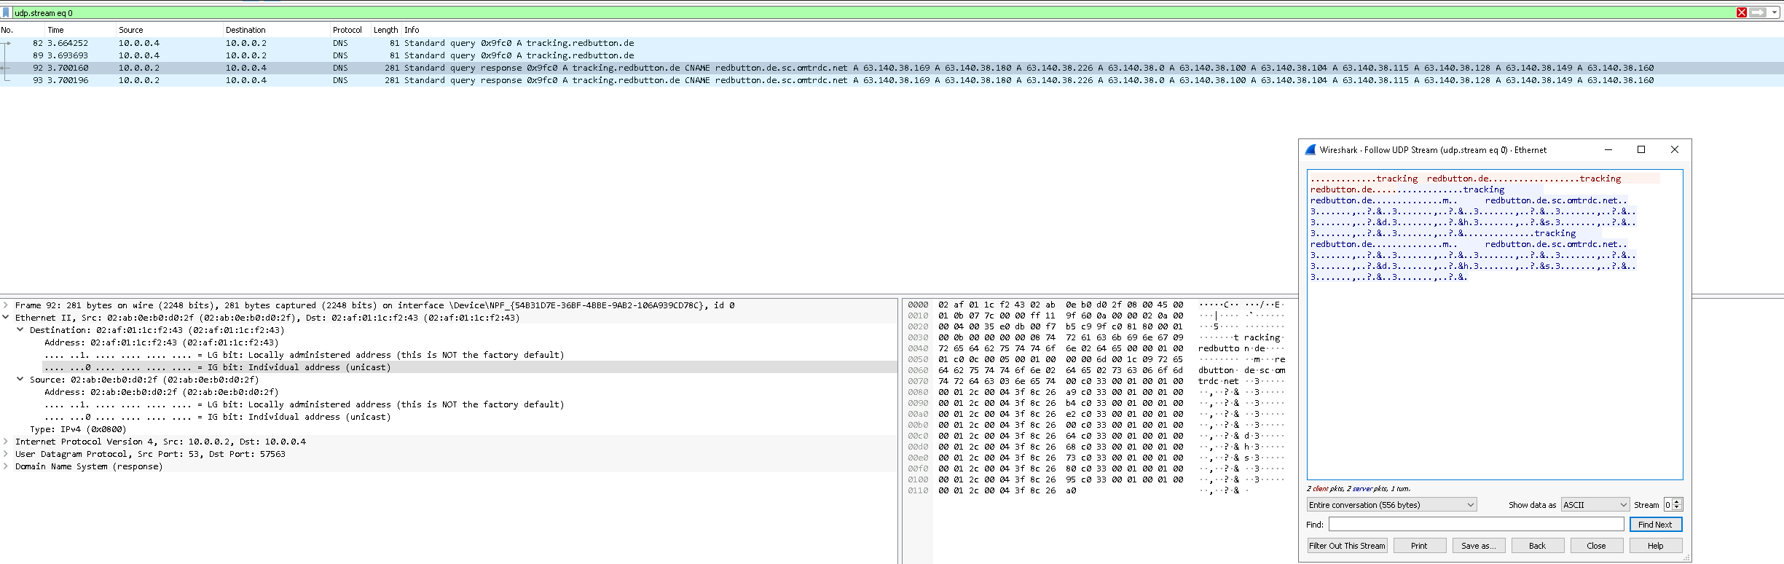
Basic Dynamic Analysis: wIRESHARK

Slide 40
Advanced Dynamic Analysis
From running excelsheet.dll using the x64dbg no new information could be learned about the sample.

Slide 41
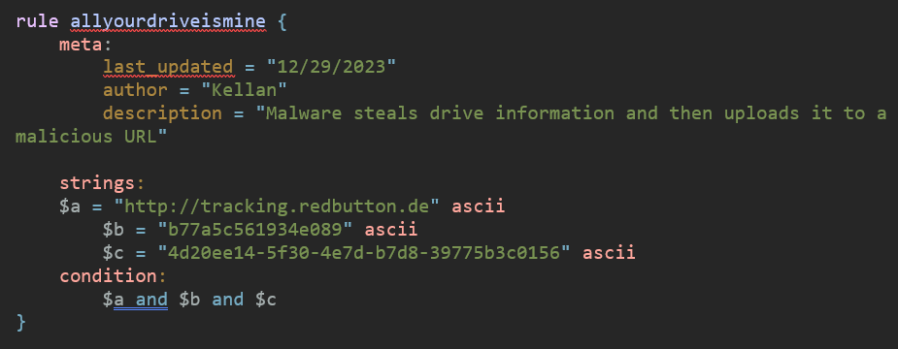
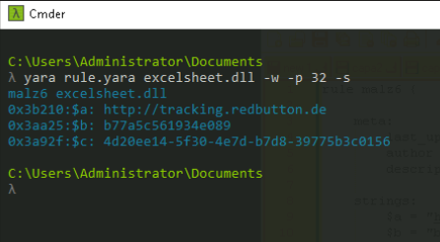
Yara Rules

Slide 42
Thank you
kellanj103@proton.me

Slide 43



Digital Communications
Cloud
Local
Hybrid

